Slide 1
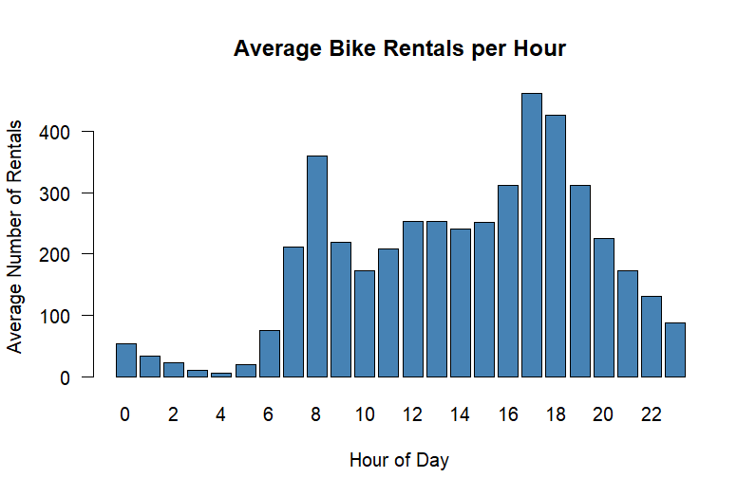
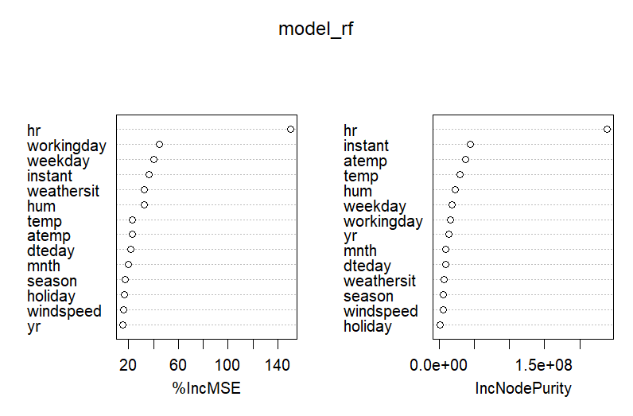
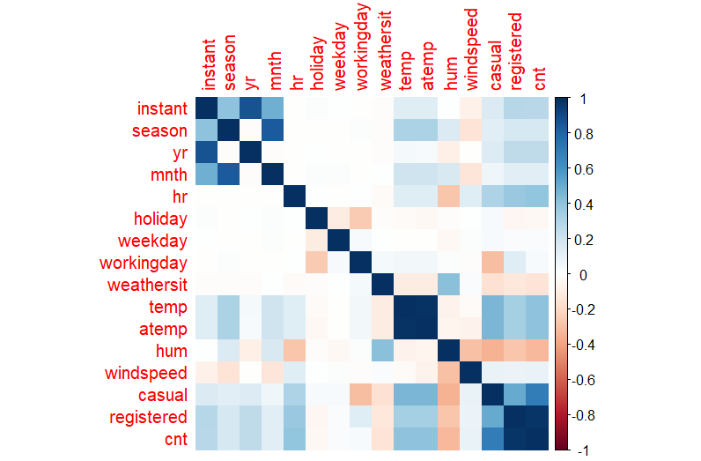
Bike Rental Data
Sal Pusateri
Bellarmine University 2026
Introduction and Motivation
The data Graphically
Results
In many cities, especially large ones, there are many forms of public transportation and private transportation. One of such forms is rental bikes to help pedestrians get around easier over longer distances and may be more convenient than subways or busses.
As one who travels a good bit, it is of interest to see what are more effective than other forms of transport and when it would best be utilized.
Bikes are rented more commonly in summer and fall than in winter and spring, though all 4 seasons were within the 4232-4496 range, so it’s not a dramatic difference.
The hour of the day was the most significant predictor in determining the number of bike rentals, which makes sense, people are going to use them to get to work, get away from work, or on their lunch break primarily, at least in D.C. The most common days were also weekdays in terms of the number of rentals. Again, makes sense.
The models created and tested, scored very highly in regards to their predictive power in determining the number of bikes that would be rented.
Objectives of the project
The objectives in this project are as follows:
To review and report on any findings in the data pre-modeling
To construct predictive models on when rental bikes are utilized (rented) most to help with planning purposes in regards to expanding this project to more cities.
To check feasibility of these expansions, meaning if they are self sufficient or would require additional funding to cover the costs of implementation.
Conclusions
I’ve concluded that after my research, if this system is as effective as it is in D.C. it should be equally, if not more, effective in cities such as New York, or Miami, or Los Angeles, all of which have very dense populations and more importantly, people who live in these cities, unlike in D.C. where there is significantly less individuals actually living in the city and that has little to no nightlife.

